Slide 1

Chapter 8
Switching

Slide 2

Switching
Switching
  Switches are devices capable of creating temporary connections between two or more devices linked to the switch.

Slide 3

Figure 8.2 Taxonomy of switched networks

Slide 4
8-1 CIRCUIT-SWITCHED NETWORKS
A circuit-switched network consists of a set of switches connected by physical links. A connection between two stations is a dedicated path made of one or more links. However, each connection uses only one dedicated channel on each link. Each link is normally divided into n channels by using FDM or TDM.
Topics discussed in this section:
Three Phases
Efficiency
Delay
Circuit-Switched Technology in Telephone Networks

Slide 5

Figure 8.3 A trivial circuit-switched network

Slide 6
A trivial circuit-switched network
When end system A needs to communicate with sys. M
  Setup Phase ; System A needs to request a connection to M that must be accepted by all switches as well as by M itself.
    A channel is reserved on each link, and the combination of channels defines the dedicated path.
  Data transfer ; After the dedicated path made of connected channels is established, data transfer can take place.
  Teardown Phase ; After all data have been transferred, the circuits are torn down.

Slide 7

Note
In circuit switching, the resources need to be reserved during the setup phase;
the resources remain dedicated for the entire duration of data transfer until the teardown phase.

Slide 8
Example 8.1
As a trivial example, let us use a circuit-switched network to connect eight telephones in a small area. Communication is through 4-kHz voice channels. We assume that each link uses FDM to connect a maximum of two voice channels. The bandwidth of each link is then 8 kHz. Figure 8.4 shows the situation. Telephone 1 is connected to telephone 7; 2 to 5; 3 to 8; and 4 to 6. Of course the situation may change when new connections are made. The switch controls the connections.

Slide 9

Figure 8.4 Circuit-switched network used in Example 8.1

Slide 10
Example 8.2
As another example, consider a circuit-switched network that connects computers in two remote offices of a private company. The offices are connected using a T-1 line leased from a communication service provider. There are two 4 × 8 (4 inputs and 8 outputs) switches in this network. For each switch, four output ports are folded into the input ports to allow communication between computers in the same office. Four other output ports allow communication between the two offices. Figure 8.5 shows the situation.

Slide 11

Figure 8.5 Circuit-switched network used in Example 8.2

Slide 12
Three Phase
As in a circuit-switched network, a source and destination need to go through three phases in a virtual-circuit network;
set-up, data transfer, and teardown.
  Set-up phase
    Suppose source A needs to create a virtual circuit to B.
    Two steps are required; set-up & acknowledgement.
  Data transfer phase
    The data transfer phase is active until the source sends all its frames to the destination.
  Teardown phase
    Source A, after sending all frames to B, send a special frame called a teardown request.
    Destination B responds with a teardown confirmation frame.
    All switches delete the corresponding entry from their table.

Slide 13
Efficiency & delay
Efficiency
  Circuit switched networks are not as efficient as the other two types of networks because resources are allocated during the entire duration of the connection.
  These resources are unavailable to other connections.
Delay
  Although a circuit-switched network normally has low efficiency, the delay in this type of network is minimal.
  During data transfer the data are not delayed at each switch; the resources are allocated for the duration of the connection.

Slide 14

Figure 8.6 Delay in a circuit-switched network

Slide 15
Note
Switching at the physical layer in the traditional telephone network uses
the circuit-switching approach.

Slide 16
8-2 DATAGRAM NETWORKS
In data communications, we need to send messages from one end system to another. If the message is going to pass through a packet-switched network, it needs to be divided into packets of fixed or variable size. The size of the packet is determined by the network and the governing protocol.
Topics discussed in this section:
Routing Table
Efficiency
Delay
Datagram Networks in the Internet

Slide 17
Note
In a packet-switched network, there
is no resource reservation;
resources are allocated on demand.

Slide 18

Datagram network
In datagram network, each packet is treated independently of all others.
  Even if a packet is part of a multipacket transmission, the network treats it as though it existed alone.
Figure 8.7 A datagram network with four switches (router)

Slide 19

Routing table
Figure 8.8 Routing table in a datagram network
A switch in a datagram network uses a routing table that is based on the destination address.

Slide 20
Note
The destination address in the header of a packet in a datagram network
remains the same during the entire journey of the packet.
The efficiency of a datagram network is better than that of a circuit-switched network; resources are allocated only when there are packets to be transferred.

Slide 21

Delay
There may be greater delay in a datagram network than in a
virtual-circuit network.
  Total delay = 3T + 3זּ+ w₁ + w₂
  Where, T=Transmission time, זּ =Propagation delay, w=Waiting time
Figure 8.9 Delay in a datagram network

Slide 22
Note
Switching in the Internet is done by using the datagram approach
to packet switching at
the network layer.

Slide 23
8-3 VIRTUAL-CIRCUIT NETWORKS
A virtual-circuit network is a cross between a circuit-switched network and a datagram network. It has some characteristics of both.
Topics discussed in this section:
Addressing
Three Phases
Efficiency
Delay
Circuit-Switched Technology in WANs

Slide 24
Virtual-Circuit Network
Characteristics of Virtual-circuit network
  As in a circuit-switched network, there are setup and teardown
  phases in addition to the data transfer phase.
  Resources can be allocated during the setup phase, as in a
  circuit -switched network, or on demand, as in a datagram network.
  As in a datagram network, data are packetized and each packet
  carries an address (local jurisdiction) in the header.
  As in a circuit network, all packets follow the same path
  established during the connection.
  A virtual-circuit network is normally implemented in the data link
  layer, while a circuit-switched network is implemented in the
  physical layer and a datagram network in the network layer.

Slide 25

Virtual-Circuit Network
The virtual-circuit network has switches that allow traffic from
sources to destinations.
A source or destination can be a computer, packet switch, or other
device that connects other network.
Figure 8.10 Virtual-circuit network

Slide 26
Global Addressing
In virtual circuit networks,
  A global address that can be unique in the scope of the WAN or international network.
  global addressing in virtual circuit networks is used only to create a virtual circuit identifier.

Slide 27
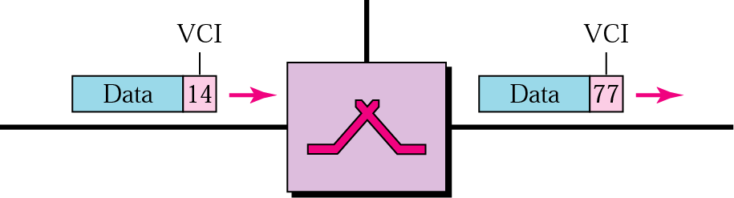
Virtual Circuit Identifier (VCI)
VCI is actually used for data transfer.
VCI (Virtual Circuit Identifier)
  is a small number that only has switch scope,
  it is used by a frame between two switches.
Each switch can use its own unique set of VCIs

Slide 28
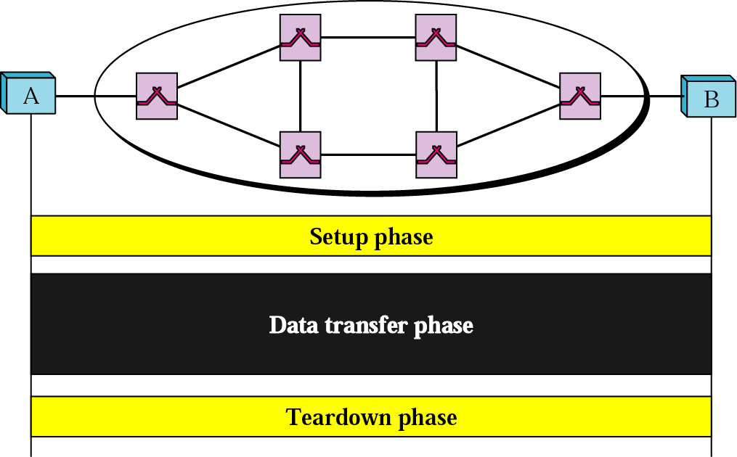
Three Phases
To communicate, a source and destination need to go through three phases
  설정(setup), 데이터전송(data transfer), 해제(teardown) 단계

Slide 29
Three Phases
In the setup phase, the source and destination use their global addresses to help switches make table entries for the connection.
In the teardown phase, the source and destination inform the switches to erase the corresponding entry.
Data phase occurs between these two phases.

Slide 30
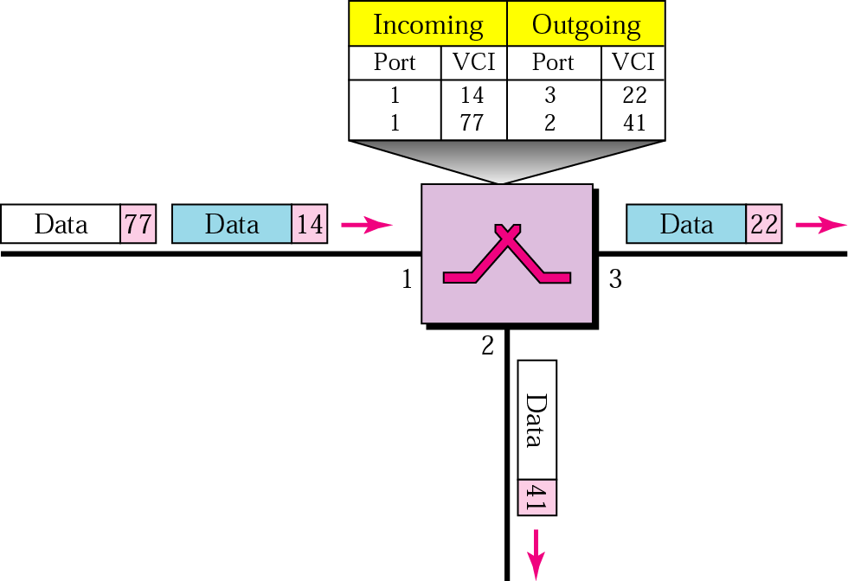
Data Transfer Phase
To transfer a frame from a source to its destination, all switches need to have a table entry for this virtual circuit.

Slide 31
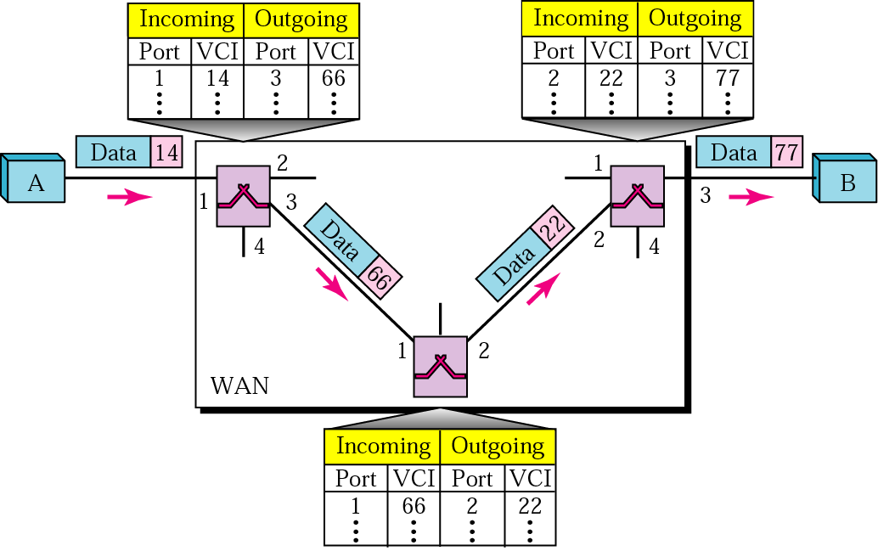
Data Transfer Phase (cont’d)
Source-to-destination data Transfer

Slide 32
Setup Phase
How does a switch create an entry for a virtual circuit?
  Switched virtual circuit (SVC) approach
    Suppose source A needs to create a virtual circuit to B.
    Two steps are required;
      the setup request and the acknowledgment.

Slide 33
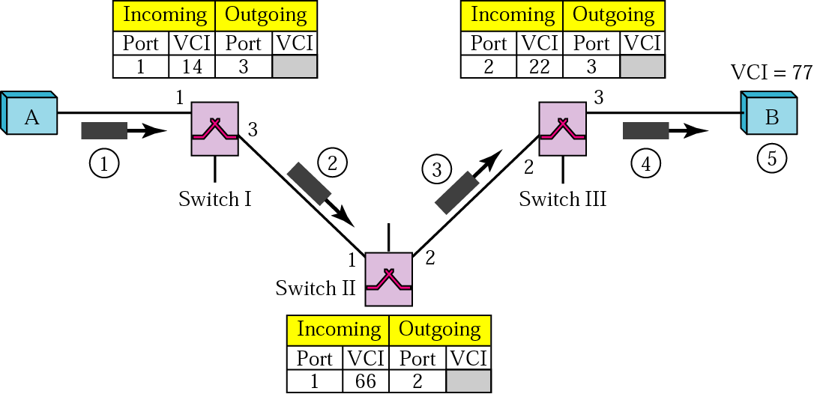
Switched Virtual Circuit (SVC)
Creating temporary and short connection that exists only when data are being transferred between source and destination.
Setup request
VCI (77) lets the destination know that
the frames come from A and not
other sources

Slide 34
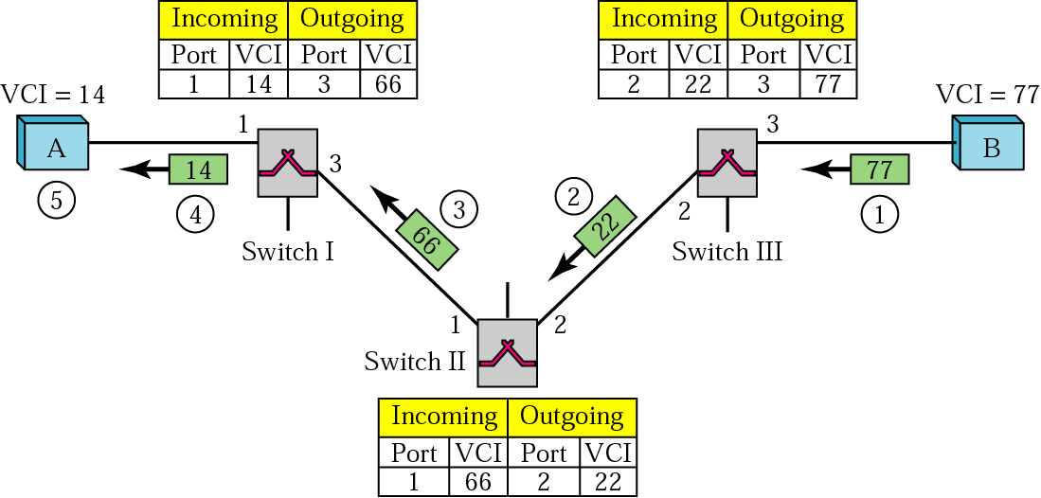
SVC (cont’d)
SVC setup acknowledgment

Slide 35
Teardown Phase
In this phase, source A, after sending all frames to B, sends a special frame called a teardown request.
Destination B responds with a teardown confirmation frame.
All switches erase the corresponding entry from their tables.

Slide 36
Efficiency
Note
In virtual-circuit switching, all packets belonging to the same source and
destination travel the same path;
but the packets may arrive at the destination with different delays
if resource allocation is on demand.

Slide 37

Delay in Virtual-circuit networks
There is a one-time delay for setup and a one-time delay for
teardown.
If resources are allocated during the setup phase, there is no wait
time for individual packets.
Total delay time = 3T + 3 זּ + setup delay + teardown time

Slide 38
Note
Switching at the data link layer in a switched WAN is normally
implemented by using
virtual-circuit techniques.

Slide 39
8.4 STRUCTURE OF A SWITCH
We use switches in circuit-switched and packet-switched networks. In this section, we discuss the structures of the switches used in each type of network.
Topics discussed in this section:
Structure of Circuit Switches
Structure of Packet Switches

Slide 40
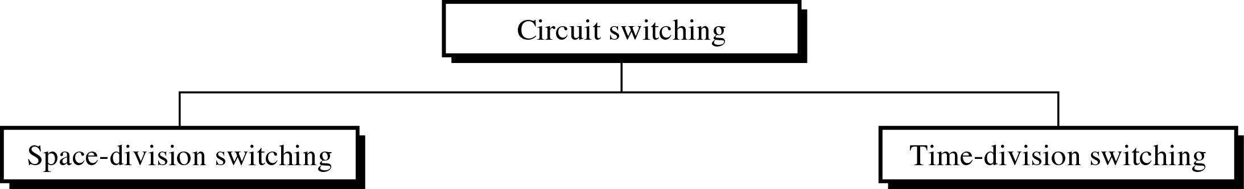
Circuit Switching(cont’d)
Structure of Circuit Switching
~ can use either two technologies.
Switching

Slide 41
Circuit Switching(cont’d)
Space-Division Switches
  the paths in the circuit are separated from each other spatially(crossbar switch)
Crossbar switch
  ~ connect n input to m output in a grid, using electronic microswitch(transistor) at each crosspoint.

Slide 42

Circuit Switching(cont’d)
Figure 8.17 Crossbar switch with three inputs and four outputs

Slide 43
Circuit Switching(cont’d)
Limitation of crossbar switch
  The number of switch (huge size)
  : connect n inputs by m output
    require n * m crosspoint.
  (ex : 1000 input, 1000 output → 1,000,000 crosspoint)
  inefficient
    fewer than 25% of the crosspoints are in use at a given time.
    the rest are idle

Slide 44

Circuit Switching(cont’d)
Multistage switch
  ~ combines crossbar switches in several (normally three) stages to solve the limitation of the crossbar switch.
Figure 8.18 Multistage switch

Slide 45
Circuit Switching(cont’d)
Multistage switch
Note
In a three-stage switch, the total
number of crosspoints is
2kN + k(N/n)²
which is much smaller than the number of crosspoints in a single-stage switch (N²).

Slide 46
Example 8.3
Design a three-stage, 200 × 200 switch (N = 200) with
k = 4 and n = 20.
Solution
In the first stage we have N/n or 10 crossbars, each of size 20 × 4. In the second stage, we have 4 crossbars, each of size 10 × 10. In the third stage, we have 10 crossbars, each of size 4 × 20. The total number of crosspoints is 2kN + k(N/n)², or 2000 crosspoints. This is 5 percent of the number of crosspoints in a single-stage switch (200 × 200 = 40,000).

Slide 47
Example 8.3
N=200, n=20, k=4
1st stage ; No. of switches N/n = 200/20 = 10, each of size = n x k =20 x 4
2nd stage ; No. of switches k = 4, each of size = N/n x N/n = 10 x 10
3rd stage ; No. of switches N/n = 200/20 = 10, each of size = k x n = 4 x 20
Total No. of cross points ; 10(20x4) + 4(10x10) + 10(4x20) = 2,000
or 2kN + k(N/n)² = 2x4x200 + 4(200/20)² =2,000
This is 5% of the No. of crosspoints in a single-stage switch (200 x 200 = 40,000)

Slide 48
Clos Criterion
The multistage switch has one drawback-blocking.
  Blocking refers to times when one input cannot be connected to output because there is no path available between them.
  Clos investigated the condition of nonblocking in multi-stage switches and came up with the following formula.
According to the Clos criterion:
  n = (N/2)^{1/2}
  middle-stage switches must be at least k > 2n – 1
  Crosspoints ≥ 4N [(2N)^{1/2} – 1]

Slide 49
Example 8.4
Redesign the previous three-stage, 200 × 200 switch, using the Clos criteria with a minimum number of crosspoints.
Solution
We let n = (200/2)^{1/2}, or n = 10. We calculate k = 2n − 1 = 19. In the first stage, we have 200/10, or 20, crossbars, each with 10 × 19 crosspoints. In the second stage, we have 19 crossbars, each with 20 × 20 crosspoints. In the third stage, we have 20 crossbars each with 19 × 10 crosspoints. The total number of crosspoints is 20(10 × 19) + 19(20 × 20) + 20(19 ×10) = 15,200.

Slide 50
Example 8.4
N=200, n= (N/2)² = (200/2)² =10, k=(2n-1) = (2x10 -1) = 19
1st stage ; No. of switches N/n = 200/10 = 20, each of size = n x k =10 x 19
2nd stage ; No. of switches k = 19, each of size = N/n x N/n = 20 x 20
3rd stage ; No. of switches N/n = 200/10 = 20, each of size = k x n = 19 x 10
Total No. of cross points ; 20(10x19) + 19(20x20) + 20(19x10) = 15,200
or 4N {(2N)^{1/2} -1}= 4x200 {(2x200)^{1/2} -1}= 15,200
This is 38% of the No. of crosspoints in a single-stage switch (200 x 200 = 40,000)
More points are needed than in Ex.8.3 (5%)
The extra crosspoints are needed to prevent blocking.

Slide 51
Circuit Switching(cont’d)
Time-Division Switch
  uses Time-division multiplexing (TDM) inside a switch.
  The most popular technology is called the time-slot
  interchange (TSI).
    TSI changes the ordering of the slots based on the desired connections.

Slide 52
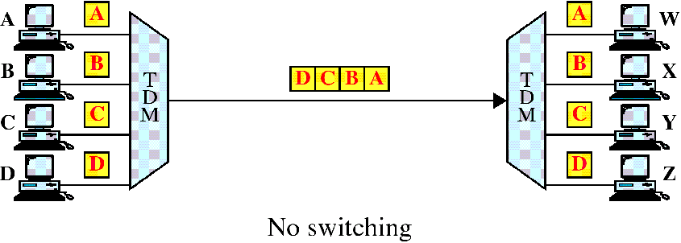
Circuit Switching(cont’d)
Time-division multiplexing without a time-slot interchange(TSI)

Slide 53
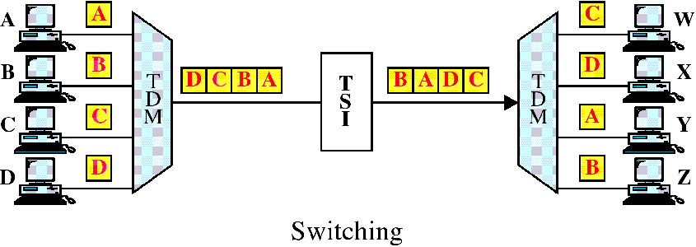
Circuit Switching(cont’d)
Time-division multiplexing with a time-slot interchange(TSI)

Slide 54

Circuit Switching(cont’d)
TSI 동작과정
Figure 8.19 Time-slot interchange

Slide 55
Circuit Switching(cont’d)
Space-and Time-Division Switching Combinations
  ~ combine space-division and time-division technology to take advantage of the best of both
  TST(time-space-time)
  TSST(time-space-space-time)
  STTS(space-time-time-space)

Slide 56

Circuit Switching(cont’d)
Figure 8.20 Time-space-time switch

Slide 57

Structure of Packet switches
A switch used in a packet-switched network has a different structure from a switch used in a circuit-switched network.
A packet switch has four components;
  input ports, output ports, the routing processor, and the switching fabric.
Figure 8.21 Packet switch components

Slide 58

Structure of Packet switches
Figure 8.22 Input port
An input port performs the physical and data link functions
of the packet switch.

Slide 59

Structure of Packet switches
Figure 8.23 Output port
An output port performs the same functions as the input port,
but in the reverse order.

Slide 60
Structure of Packet switches
Routing Processor
  The routing processor performs of the network layer.
Switching fabrics
  The most difficult task in a packet switch is to move the packet
  from the input queue to the output queue.
  Today, packet switches are specialized mechanisms that use
  a variety of switching fabrics.
    Crossbar switch : Simplest type of switching fabric is the
    crossbar switch.

Slide 61

Structure of Packet switches
Figure 8.24 A banyan switch
A banyan switch is a multistage switch with microswitches at each stage that route the packets based on the output port represented as a binary string.

Slide 62

Structure of Packet switches
Figure 8.25 Examples of routing in a banyan switch

Slide 63

Structure of Packet switches
Figure 8.26 Batcher-banyan switch
Batcher-banyan switch has designed to solve the problem of banyan switch that comes before the banyan switch and sorts the incoming packets according to their final destination.

Slide 64

Q & A

